Slide 1

NITTE MEENAKSHI INSTITUTE OF TECHNOLOGY
Presentation On
Gender Detection System using FFT with ANN
Presenting by:
SHANTAM VIJAYPUTRA, NMIT BANGALORE
Under guidance of :
DR. NALINI N, PROFESSOR, NMIT BANGALORE

Slide 2
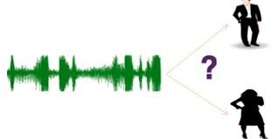
Gender Detection System using FFT with ANN
FFT

Slide 3

WHY ?

Slide 4





Result/Predictions
STEPS INVOLVED
Analyzing/Tuning
Training/Testing
Preprocessing
Data Extraction

Slide 5
Data Extraction and Loading
Loading:-
Audio Files
Scipy Audio Tool
Numeric Dataset(Array)

Slide 6
FFT Transformation (Why ?)
$\sum_{n=0}^{N−1}{a_{n}e^{\frac{−2πink}{N}}}$
=
$\sum_{n=0}^{\frac{N}{2}−1}{a_{2n}e^{\frac{−2πi\left(2n\right)k}{N}}}$
$\sum_{n=0}^{\frac{N}{2}−1}{a_{\left(2n+1\right)}e^{\left(−2πi\left(2n+1\right)k/N\right)}}$
+
$\sum_{n=0}^{\frac{N}{2}−1}{a_{n}^{even}e^{\frac{−2πi\left(n\right)k}{N/2}}}$
$e^{−2{πik}/N}\sum_{n=0}^{\frac{N}{2}−1}{a_{n}^{odd}}e^{\frac{−2πink}{N/2}}$
=
+
APPLICATIONS:
Fast large integer and polynomial multiplication
Efficient matrix-vector multiplication for Toeplitz, circulate and other structured matrices
Filtering algorithms (see overlap-add and overlap-save methods)
Fast algorithms for discrete cosine or sine transforms (example, Fast DCT used for JPEG, MP3/MPEG encoding)
Fast Chebyshev approximation
Fast discrete Hartley transform
Solving difference equations
Computation of isotopic distributions.

Slide 7
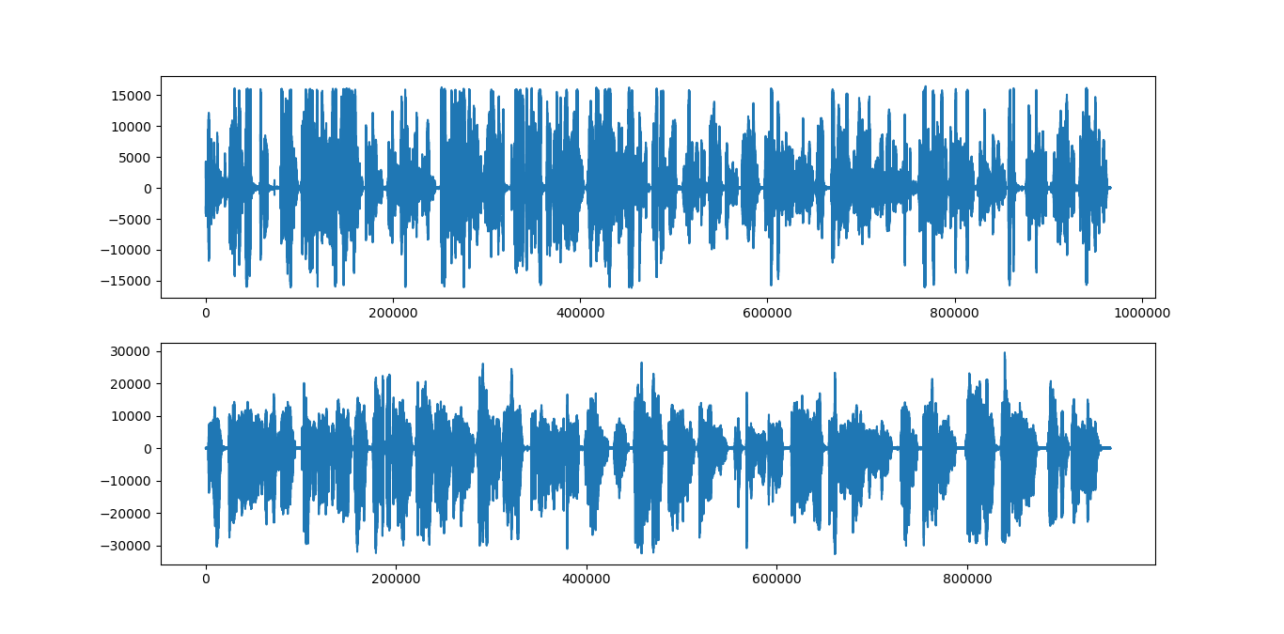
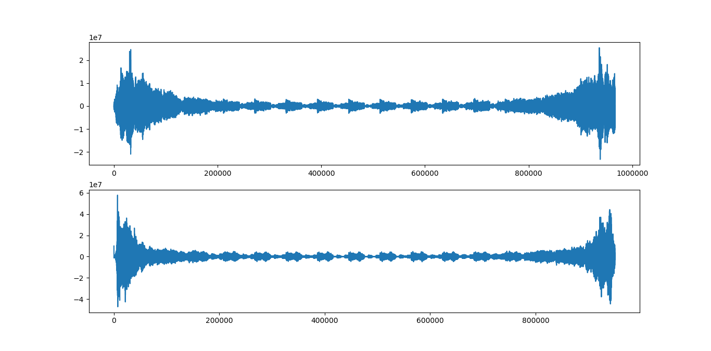
Audio Data Transformation
Output Data
Input Data

Slide 8
Features Extraction
IQR
Transformed Audio Data
Median
Mode
Skewness
Mean frequency
Kurtosis
Extracted Dataset
Q25
Q75
Sp.ent
Centroid
STD

Slide 9
Dataset Preprocessing
Taking Care of Nonvalue
Label Encoding
Feature Scaling(Min Max)

Slide 10
Training
Pre Processed Data
ANN Training
Final Training
Optimization/Parameter Tuning

Slide 11
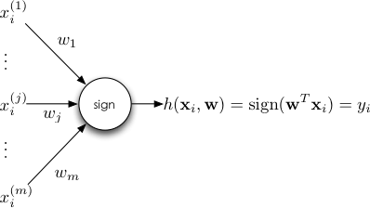
ANN:- Artificial Neural Networks
Perceptron:-

Slide 12
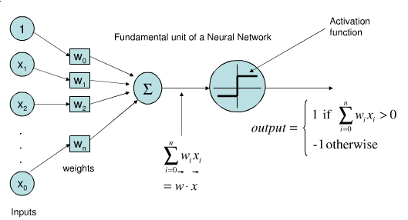
Neural Networks:-

Slide 13
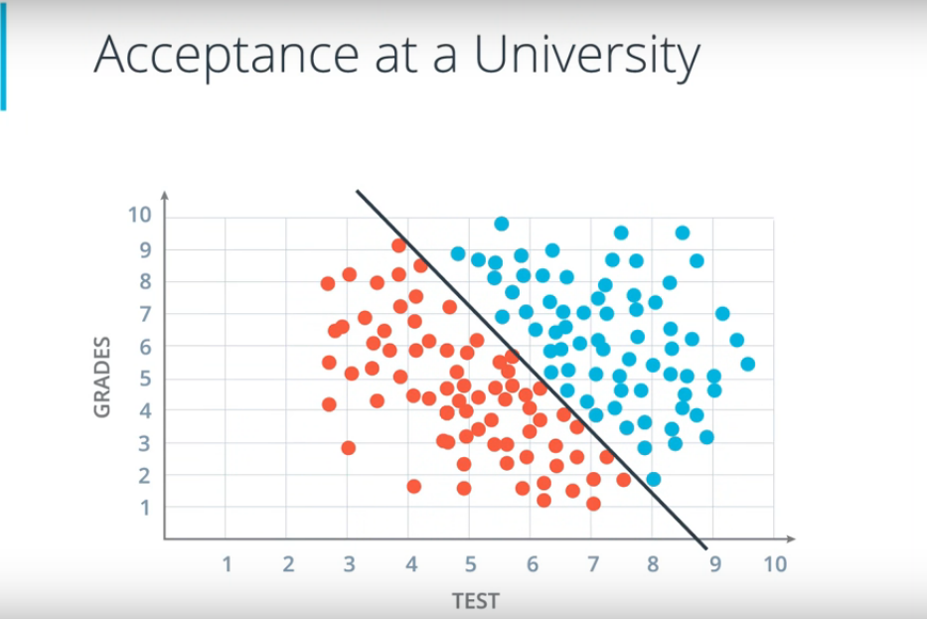
BENEFITS OF USING ANN

Slide 14
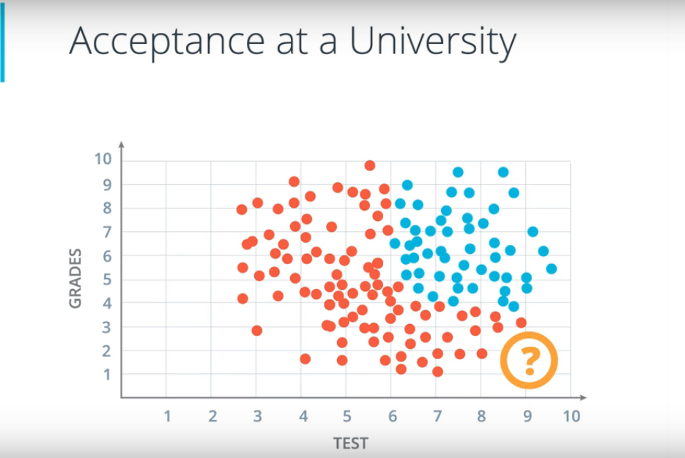

Slide 15
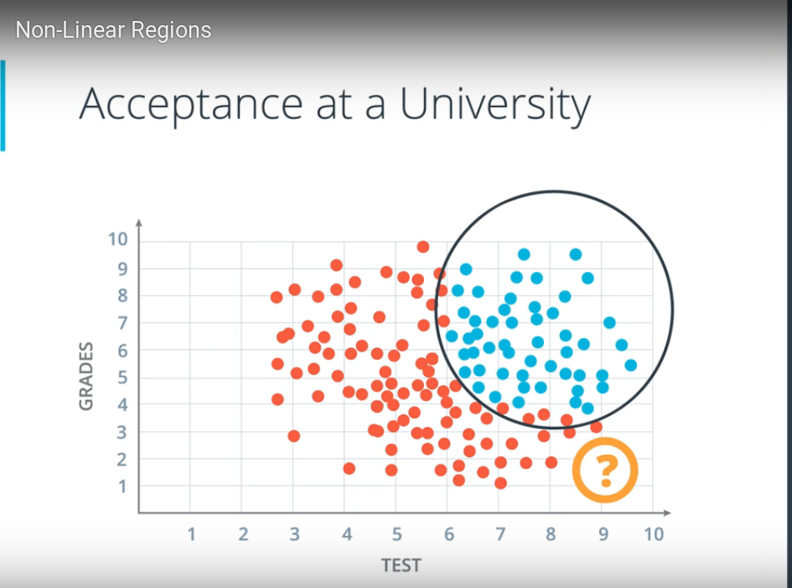

Slide 16
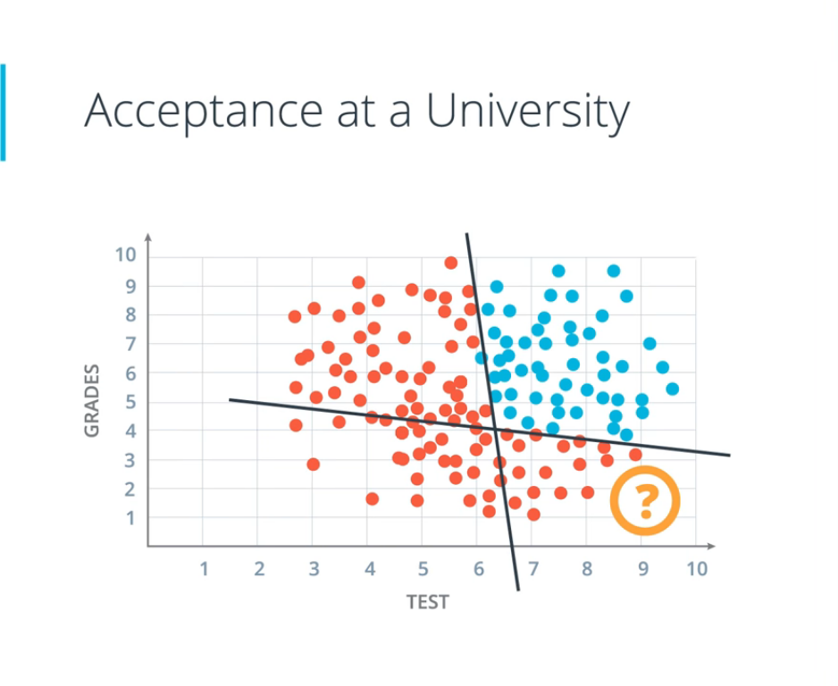

Slide 17
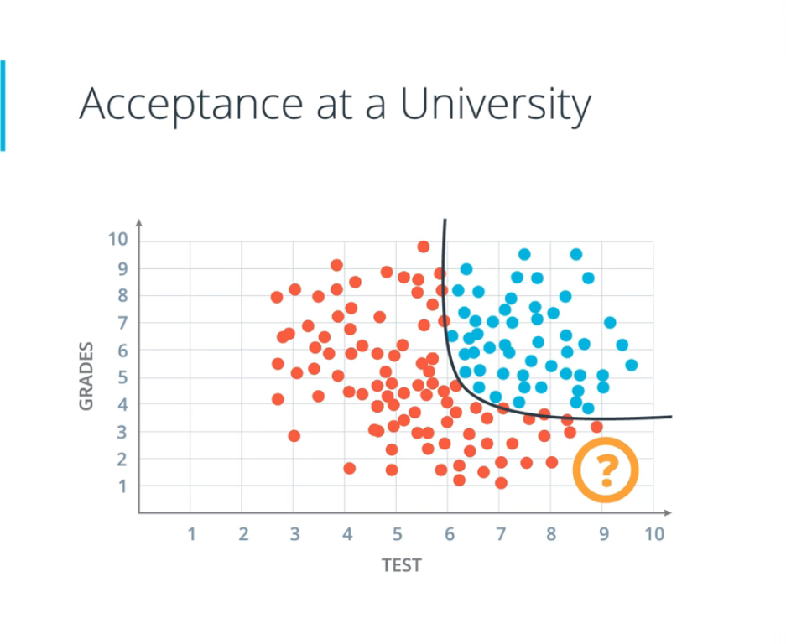

Slide 18
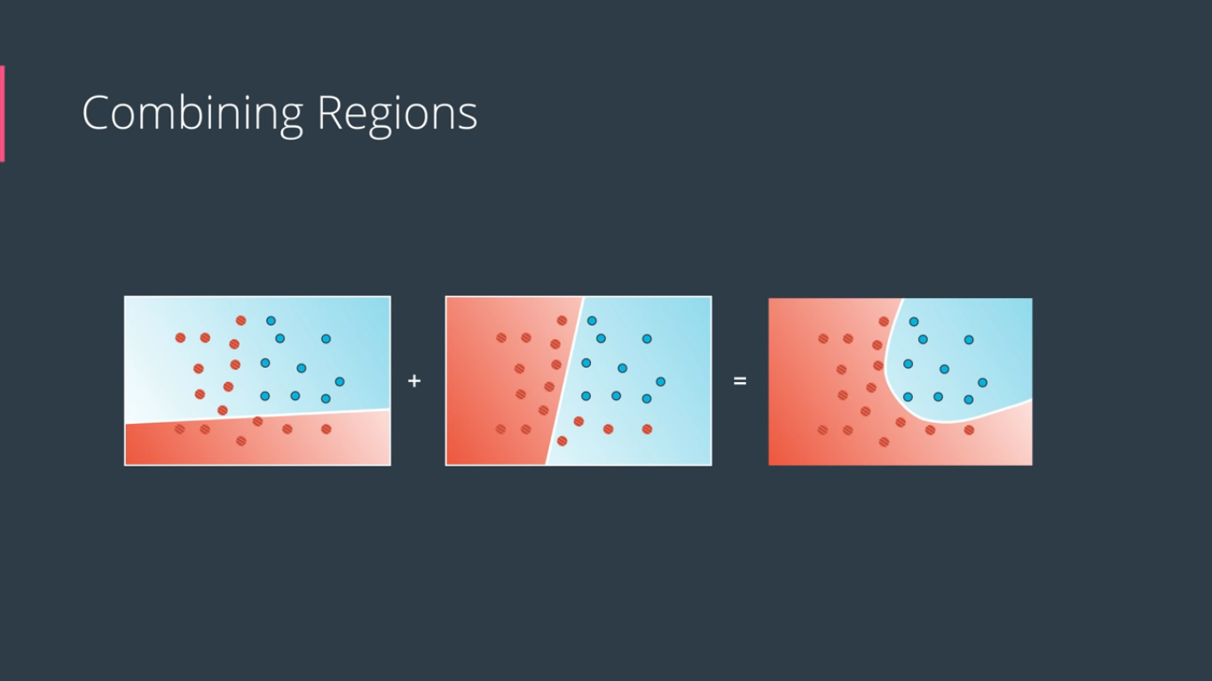

Slide 19


Slide 20
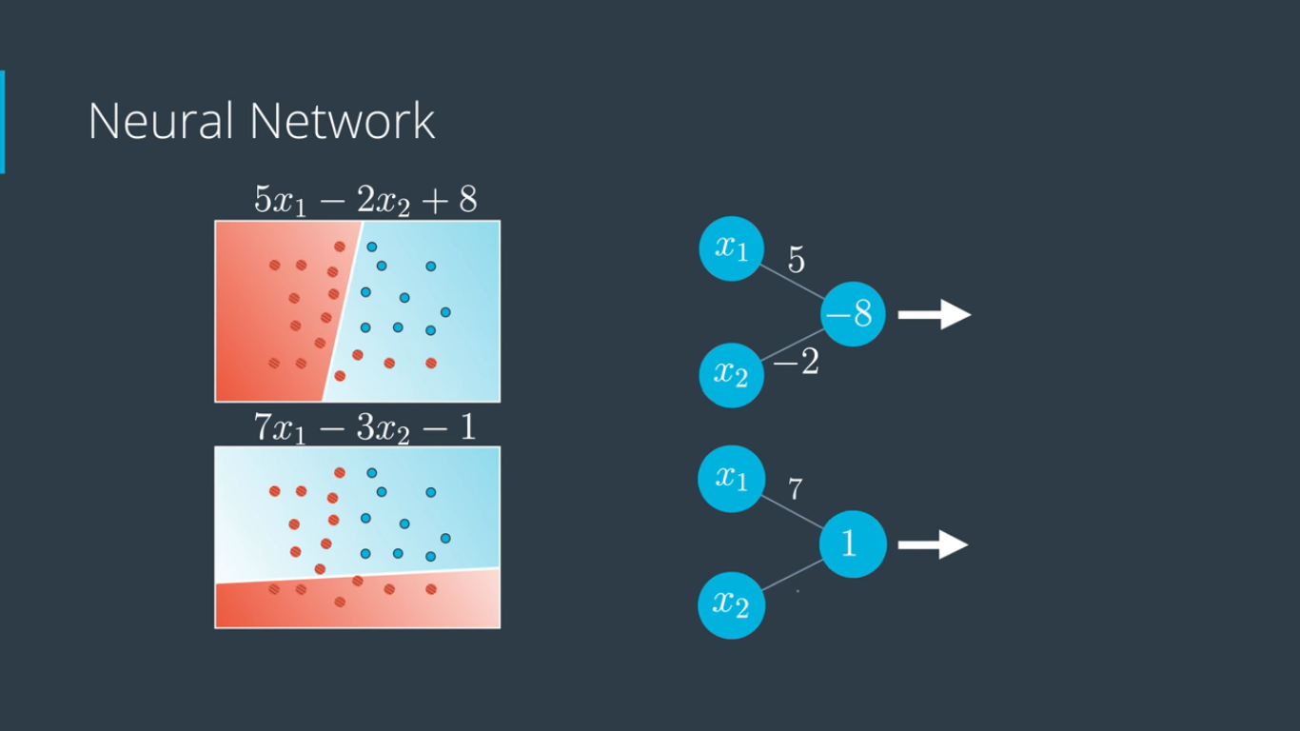

Slide 21
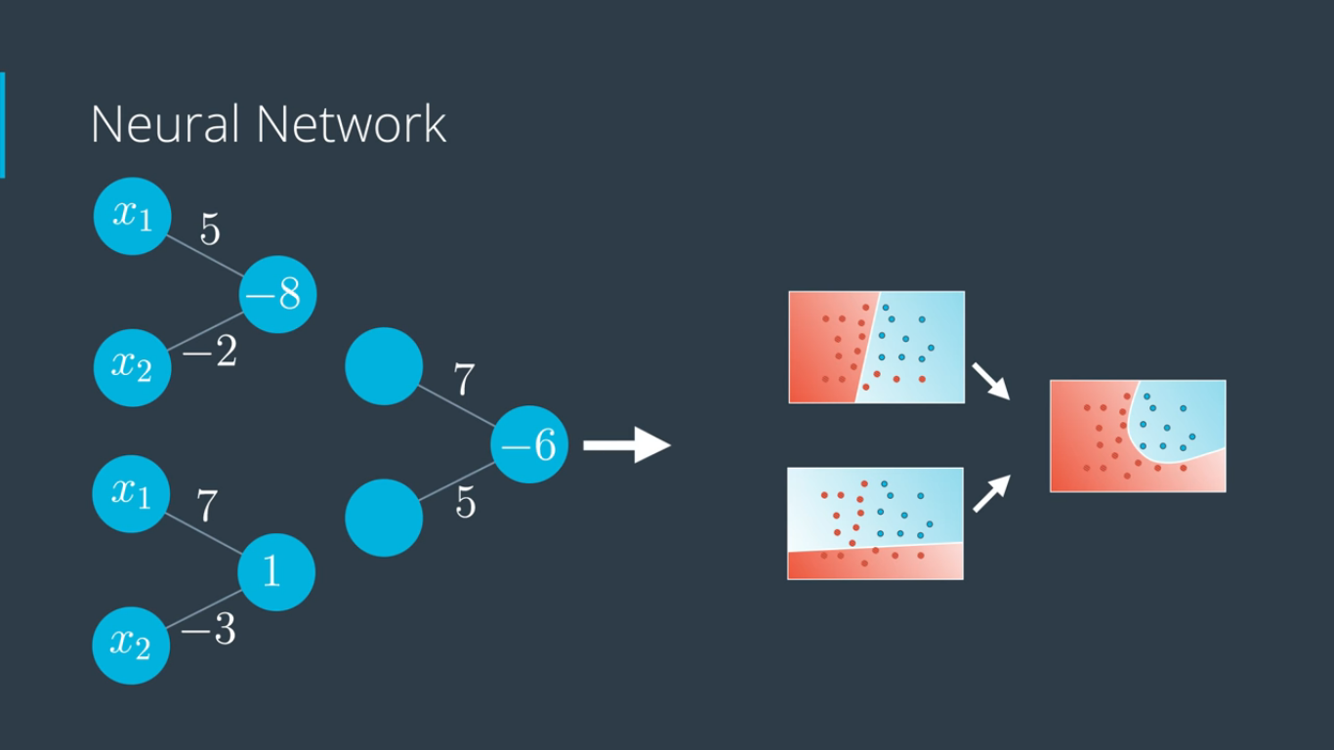

Slide 22
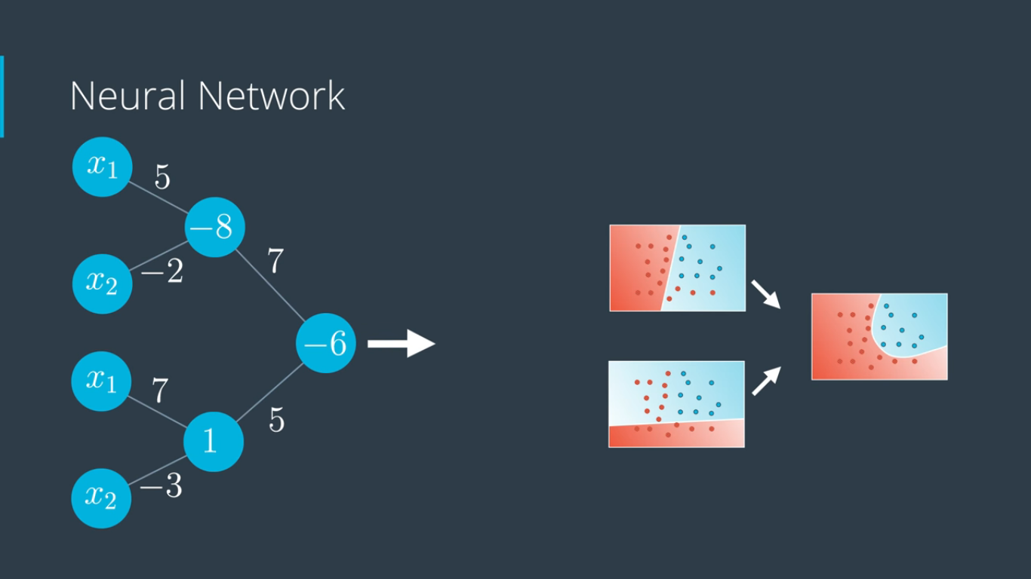

Slide 23
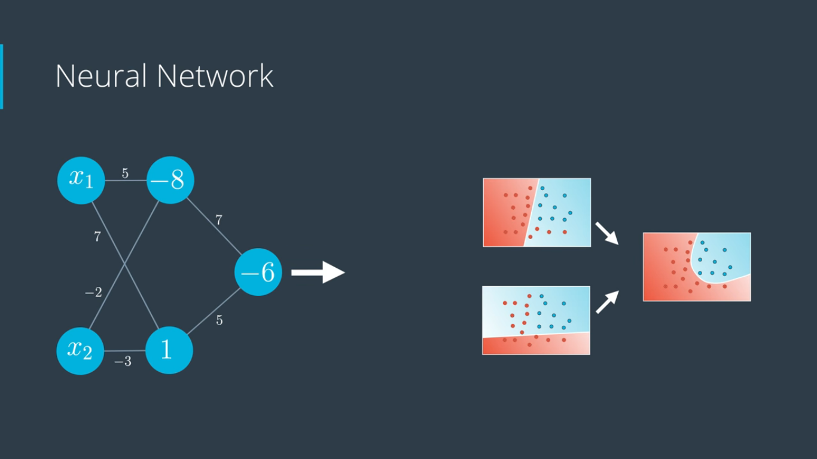

Slide 24
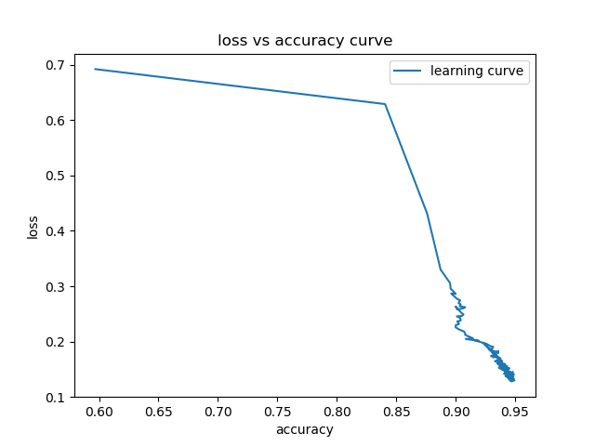
Training
Learning Curve

Slide 25
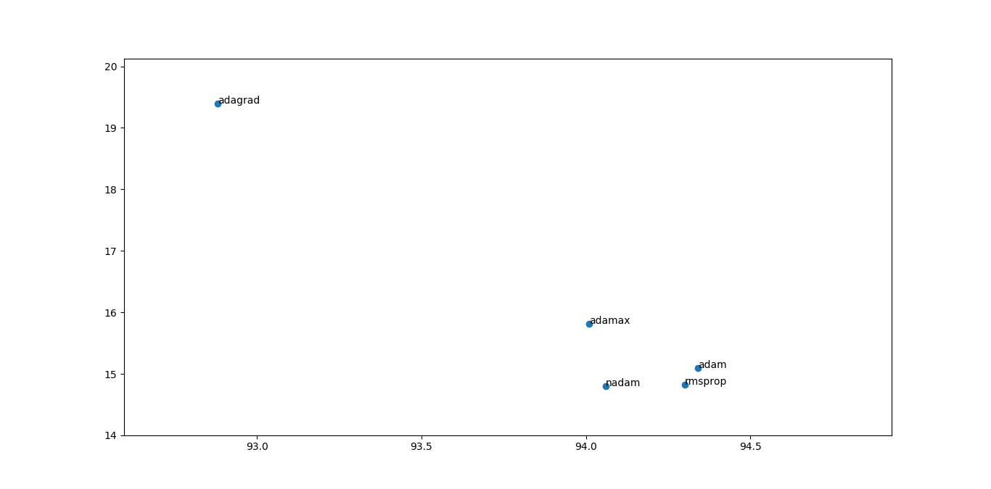
Parameter tuning
Optimizer algo vs accuracy
Optimal algorithm

Slide 26
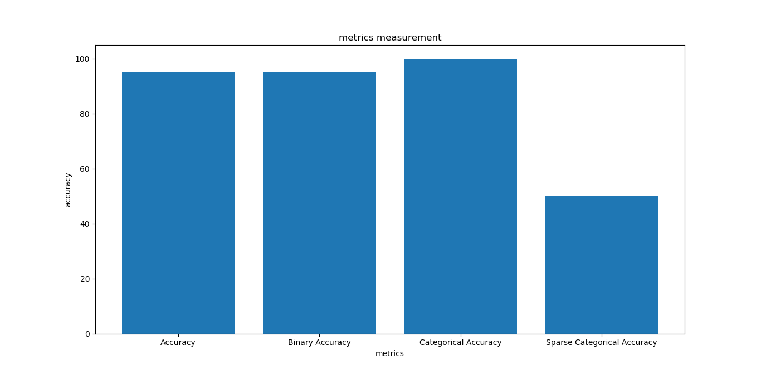
Accuracy optimization
Optimal

Slide 27
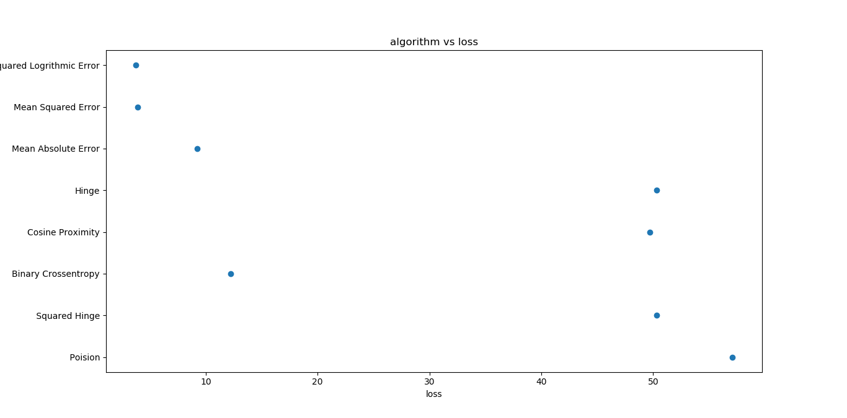
Algorithm vs Loss optimization
Optimal point with minimal Loss

Slide 28
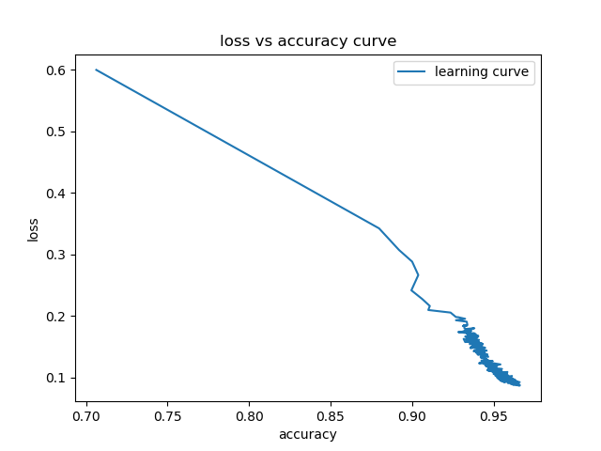
Training with optimized parameter
Smoother curve with more accuracy

Slide 29
New Predictions
Input data in proper format
Trained Classifier
Predicted / labeled output

Slide 30
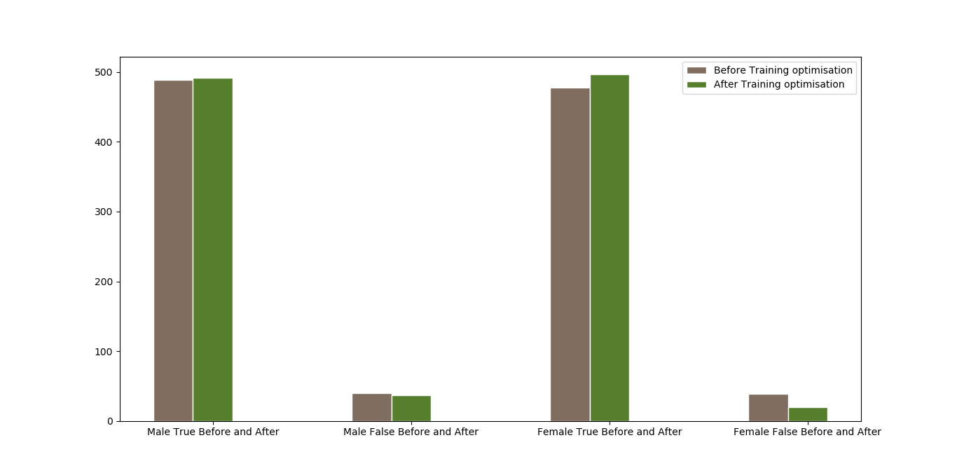

Slide 31
APPLICATIONS
One of the best application for this approach are as follows:
DETECTION OF MIMIC OF THE VOICE
LIE DETECTION
FILTERING SPAMMED AUDIO FILES ON SOCIAL MEDIAS
ETC

Slide 32
THANK YOU
THANK YOU

